Slide 1
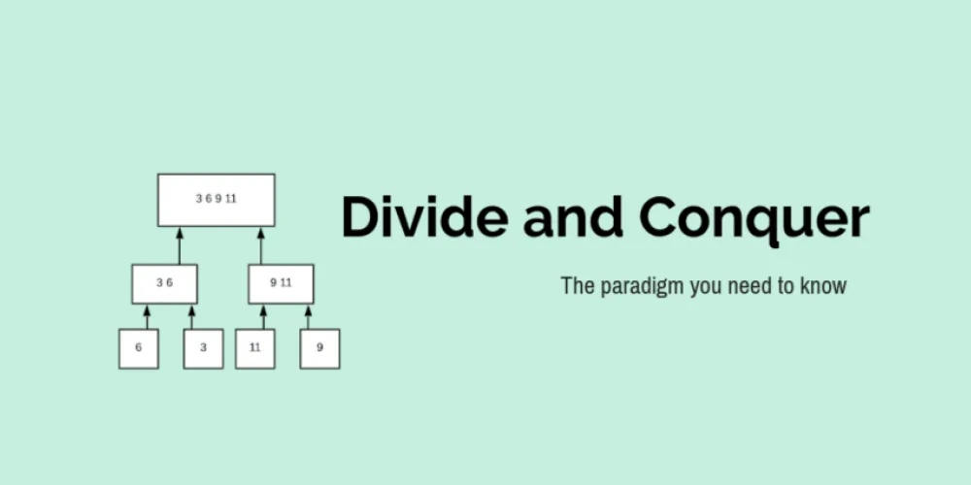

Slide 2
Introduction
Divide and Conquer is an algorithmic paradigm. A typical Divide and Conquer algorithm solves a problem using following three steps.
Divide: Break the given problem into subproblems of same type.
Conquer: Recursively solve these subproblems
Combine: Appropriately combine the answers

Slide 3
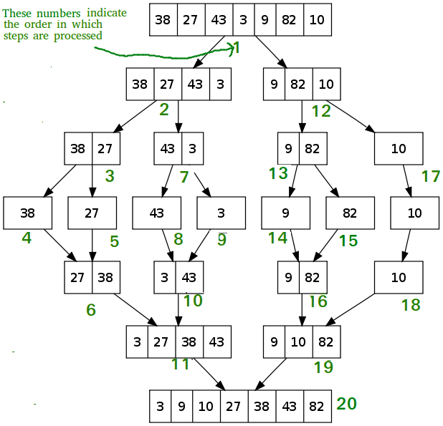
Introduction
A classic example of Divide and Conquer
is Merge Sort.
In Merge Sort, we divide array into two halves,
sort the two halves recursively,
and then merge the sorted halves.

Slide 4
General Approach
DAC(P){
if(small(P)){
S(P);
}
else{
Divide P into P₁, P₂, P₃, …, P_{k};
Apply DAC(P₁), DAC(P₂), …, DAC(P_{k});
Combine(DAC(P₁), DAC(P₂), …, DAC(P_{k}));
}
}
DAC(a, i, j){
if(small(a, i, j)){
return(Solution(a, i, j))
}
else {
m = divide(a, i, j) //f1(n)
b = DAC(a, i, mid) //T(n/2)
c = DAC(a, mid+1, j) // T(n/2)
d = combine(b, c) // f2(n)
return(d)
}
}
OR

Slide 5
Problems
These are the problems that can be solved by Divide and Conquer Approach:
Binary Search
Finding Maximum and Minimum
Merge Sort
Quick Sort
Strassen’s Matrix Multiplication

Slide 6
Merge Sort
Merge sort repeatedly breaks down a list into several sublists until each sublist consists of a single element and merging those sublists in a manner that results into a sorted list.
This can be done in two ways:
Top-down Merge Sort Implementation (Recursive Method)
Bottom-Up Merge Sort Implementation (Iterative Method)

Slide 7
Merge Sort
It starts at the Top and proceeds downwards,
with each recursive turn asking the same question such as,
“What is required to be done to sort the array?”
and having the answer as,
“split the array into two, make a recursive call, and merge the results.”,
until one gets to the bottom of the array-tree.

Slide 8
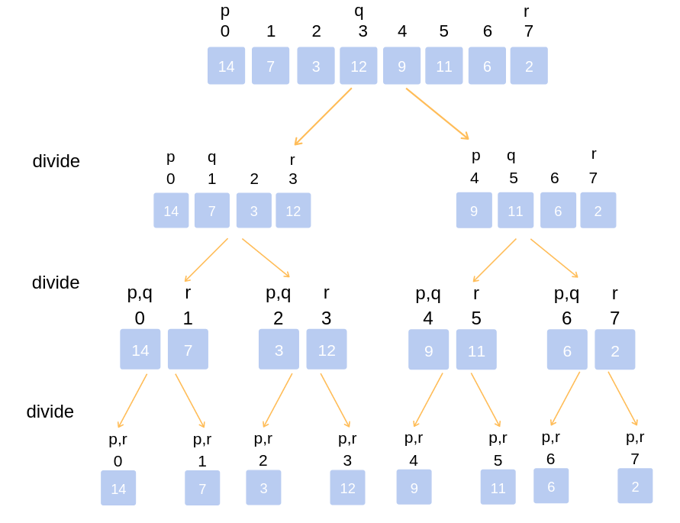
Example
Divide the unsorted list into n sublists, each comprising 1 element (a list of 1 element is supposed sorted).
Repeatedly merge sublists to produce newly sorted sublists until there is only 1 sublist remaining. This will be the sorted list.

Slide 9
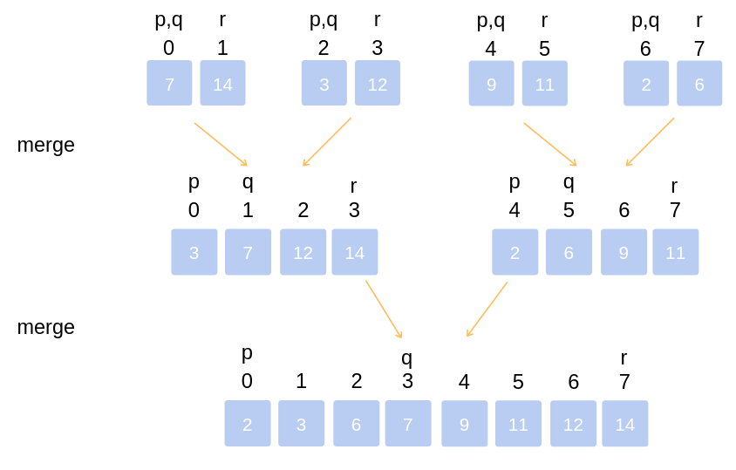
Example
The first element of both lists is compared.
If sorting in ascending order, the smaller element among two becomes a new element of the sorted list.

Slide 10
Merge Sort
void mergeSort(int *Arr, int start, int end) {
if(start < end) {
int mid = (start + end) / 2;
mergeSort(Arr, start, mid);
mergeSort(Arr, mid+1, end);
merge(Arr, start, mid, end);
}
}

Slide 11
Merge Sort
void merge(int *Arr, int start, int mid, int end) {
// create a temp array
int temp[end - start + 1];
// crawlers for both intervals and for temp
int i = start, j = mid+1, k = 0;

Slide 12
Merge Sort
while(i <= mid && j <= end) { // traverse both arrays and in each iteration add
smaller of both elements in temp
if(Arr[i] <= Arr[j]) {
temp[k] = Arr[i];
k += 1; i += 1;
}
else {
temp[k] = Arr[j];
k += 1; j += 1;
}
}

Slide 13
Merge Sort
while(i <= mid) { // add elements left in the first interval
temp[k] = Arr[i];
k += 1; i += 1;
}
while(j <= end) { // add elements left in the second interval
temp[k] = Arr[j];
k += 1; j += 1;
}

Slide 14
Merge Sort
// copy temp to original interval
for(i = start; i <= end; i += 1) {
Arr[i] = temp[i - start]
}
}
O(nlogn) - Worst case running time
O(n) - Space Complexity (not in-place)

Slide 15
Quick Sort
QuickSort is one of the most efficient sorting algorithms and is based on the splitting of an array into smaller ones.
The name comes from the fact that, quick sort is capable of sorting a list of data elements significantly faster than any of the common sorting algorithms.

Slide 16
Quick Sort
Consider a situation where one had to sort the papers bearing the names of the students, by name, with quick sort:
Select a splitting value, say L. The splitting value is also known as Pivot.
Divide the stack of papers into two. A-L and M-Z. It is not necessary that the piles should be equal.
Repeat the above two steps with the A-L pile, splitting it into its significant two halves. And M-Z pile, split into its halves. The process is repeated until the piles are small enough to be sorted easily.
Notes:
Ultimately, the smaller piles can be placed one on top of the other to produce a fully sorted and ordered set of papers.

Slide 17
Quick Sort
The approach used here is recursion at each split to get to the single-element array.
At every split, the pile was divided and then the same approach was used for the smaller piles.
Due to these features, quick sort is also called as partition exchange sort.

Slide 18
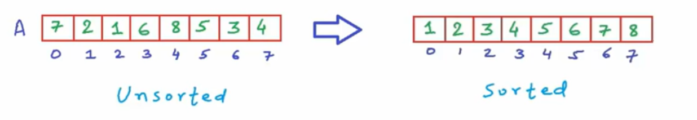
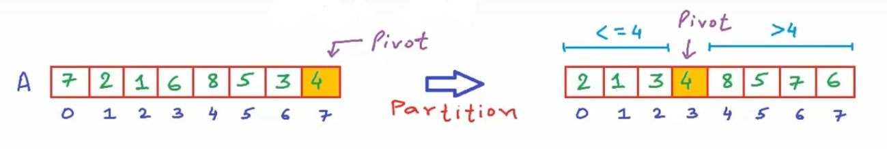
Example
Consider the following problem:
Decide any value to be the
pivot from the list (generally the last value) and call the partition function which arranges the array in such a way that pivot comes to its actual position.
Notes:
i.e to the left of the pivot, the array has all the elements less than it, and to the right greater than it.

Slide 19
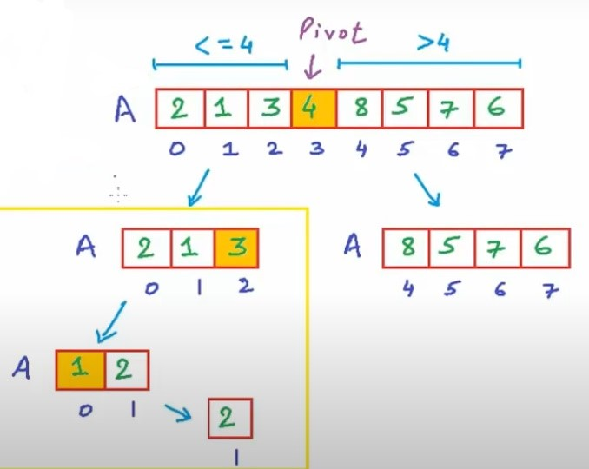
Example
After Partitioning, break the problem into two subproblems, i.e. sorting the elements to the left of the pivot and sorting the elements right of the pivot.
And continue this process recursively, till there is only one element remaining in the segment. (The exit condition)
Notes:
Note: This is not using auxiliary arrays like merge sort, it is sorting the array in-place.
All the rearrangement is happening in the original array only.

Slide 20
Code
#include<iostream>
using namespace std;
int Partition(int *A, int start, int end){
int pivot = A[end];
int partitionIndex = start; //set partition index as start initially
for (int i=start; i<end; i++){
if (A[i] <= pivot) {
swap (A[i], A[partitionIndex]); //swap if element is lesser than pivot
partitionIndex++;
}
}
swap(A[partitionIndex], A[end]); //swap pivot with element at partition index
return partitionIndex;
}

Slide 21
Code
void QuickSort(int *A, int start, int end) {
if (start < end) {
int partitionIndex = Partition(A, start, end); //calling partition
QuickSort(A, start, partitionIndex - 1);
QuickSort(A, partitionIndex + 1, end);
}
}
int main(){
int A[ ] = {7, 6, 5, 4, 3, 2, 1, 0};
QuickSort(A, 0, 7);
for (int i=0; i < 8; i++) cout<<A[i]<<” ”;
}

Slide 22
Quick Sort
O(nlogn) - Average Case Running Time
O(n²) - Worst Case Running Time
O(1) - Space Complexity (in-place)

Slide 23
Analysis of DAC
Many algorithms are recursive in nature.
When we analyze them, we get a recurrence relation for time complexity.
We get running time on an input of size n as a function of n and the running time on inputs of smaller sizes.
For e.g. In merge sort, recurrence relation is T(n) = 2T(n/2) + cn

Slide 24
Recurrence Relations
1 n=0
T(n-1)+1 n>0
T(n)
void Test(int n){
if (n>0) {
printf(“%d”, n);
Test(n-1);
}
} //T(n) = T(n-1) + 1
T(n) =
T(n) = T(n-1) + 1 ; similarly T(n-1) = T(n-2) + 1
Substitute T(n-1)
T(n) = (T(n-2) + 1) + 1
= T(n-2) + 2
= (T(n-3) + 1) + 2
= T(n-3) + 3
…. Continue for k times
T(n) = T(n-k) + k
1
T(n-1)

Slide 25
Recurrence Relations
Assume n-k = 0
i.e. k = n times
T(n) = T(n - n) + n
T(n) = T(0) + n
= 1 + n
O(n)

Slide 26
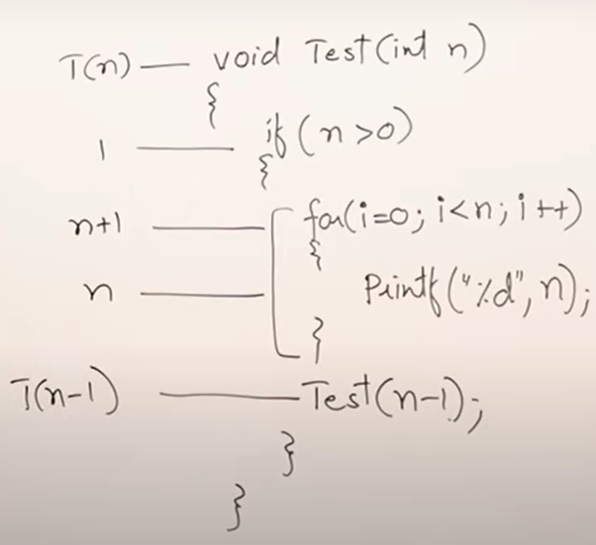
Recurrence Relations
Here, T(n) = T(n-1) + 2n + 2
= T(n-1) + n //as above expression is linear.
Solving this relation using substitution menthod, we get:
T(n) = 1 + n(n+1)/2
O(n²)
1 n=0
T(n-1)+ n n>0
T(n) =

Slide 27
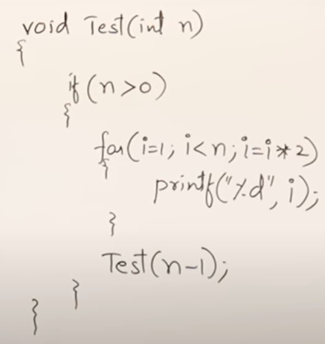
Solve for this
Find complexity of this recurrence relation.
Notes:
Answer: T(n) = 1 + logn!
O(nlogn)

Slide 28
Recurrence Relations
T(n) = T(n-1) + 1 - O(n)
T(n) = T(n-1) + n - O(n²)
T(n) = T(n-1) + logn - O(nlogn)
T(n) = T(n-1) + n² - O(n³)
T(n) = T(n-2) + 1 - O(n/2) -> O(n)
T(n) = T(n-100) + n - O(n²)

Slide 29
Recurrence Relations
Solve the given recurrence relation:
T(n) = 2T(n-1) + 1
And study about master theorem.
Notes:
Answer: T(n) = 2^{n+1}-1
O(2^{n})

